Slide 1
Publish-Subscribe
Team 4: Oroware
3/24/2020

Slide 2
What is it?
Publish subscribe is an asynchronous architecture pattern that utilizes a client server model.
By using this style of architecture, we can enable an application to announce events to multiple interested clients asynchronously, without coupling the senders to the receivers.

Slide 3
What problem does it solve?
In cloud based and distributed applications, publish-subscribe solves the problem of having to distribute relevant information to subscribers without knowing who the subscriber is.

Slide 4
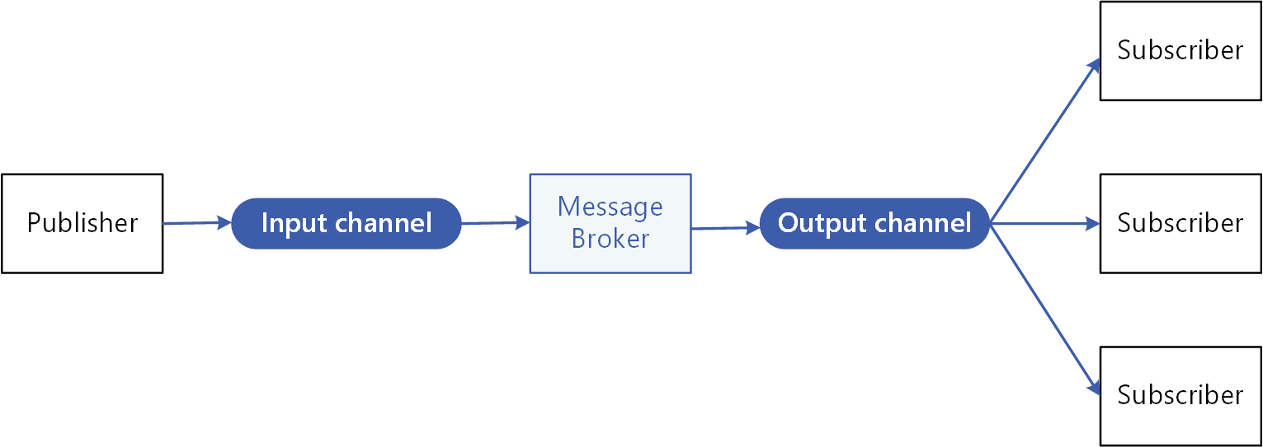
How does it solve the problem?
Using an asynchronous subsystem with the following components:
An input messaging channel
An output messaging channel
A mechanism to copy messages from the input channel to the output channel

Slide 5
What are the strengths and drawbacks?
Strengths:
It decouples subsystems that still need to communicate. Subsystems can be managed independently, and messages can be properly managed even if one or more receivers are offline.
It increases scalability and improves responsiveness of the sender. The sender can quickly send a single message to the input channel, then return to its core processing responsibilities. The messaging infrastructure is responsible for ensuring messages are delivered to interested subscribers.
It provides separation of concerns for your applications. Each application can focus on its core capabilities, while the messaging infrastructure handles everything required to reliably route messages to multiple consumers.

Slide 6
What are the strengths and drawbacks?
Drawbacks:
Recipients don’t talk back to senders. There are some exceptions but this is anonymous and infrequent.
The order in which consumer instances receive messages isn't guaranteed, and doesn't necessarily reflect the order in which the messages were created.
A malformed message, or a task that requires access to resources that aren't available, can cause a service instance to fail. The system should prevent such messages being returned to the queue.

Slide 7

Who are the actors (i.e., main elements)?
Publisher (message sender)
Has no knowledge of subscribers
Publishes message to topics/channels
Message Broker
Receives messages from Publisher
Forwards messages of interest to subscribers (based on topic)
Subscriber (message receiver)
Has no knowledge of publisher
Subscribes to a topic
Only receives messages of interest
Receiver
Topic
Sender
Receiver
Channel
Receiver

Slide 8
How do they relate to each other?
subscribers only receive messages of topics/channels they subscribe to
publisher sends messages to message broker
Receiver
Topic
Sender
Receiver
Channel
Receiver
message broker receives and forwards messages to subscribers based on topic/channel
subscribers subscribe to topics/channels

Slide 9
Example Applications
Internet of Things: Can facilitate interaction between Internet of Things devices [2]
Alert Systems: Provide asynchronous event notifications to application components
Workflow Management: Communicate events between components and data transfer
Parallel Processing: Deliver information to components that triggers the execution of tasks at the same time [2]
Serverless Systems: Coordinate components and fanout notifications to message queues

Slide 10
Security Implications
Authentication: Verifying that messages come from their claimed origin
Information Integrity: Ensuring that message information has not changed since it was sent [1]
Subscription Integrity: Preventing unauthorized modifications to subscriptions
Service Integrity: Preventing intrusions in the publish-subscribe network
Confidentiality: Hiding sensitive information from qualifying components (e.g. hiding subscriber identity from a publisher) [1]
Availability: Limiting the amount of traffic in a pub-sub network to prevent a denial of service

Slide 11
References
[1] Chenxi Wang, A. Carzaniga, D. Evans and A. L. Wolf, "Security issues and requirements for Internet-scale publish-subscribe systems," Proceedings of the 35th Annual Hawaii International Conference on System Sciences, Big Island, HI, 2002, pp. 3940-3947.
[2] S. Tarkoma, “Publish/subscribe systems: design and principles,” Amazon, 2012. [Online]. Available: https://aws.amazon.com/pub-sub-messaging/benefits/. [Accessed: 25-Mar-2020].

